Slide 1



“High-accuracy, GPS-independent time synchronization systems for 5G mobile and other critical networks and processes”
a feasibility study* to investigate the possibilities to meet the stringent requirements of accuracy and security in 5G mobile networks and other mission critical networks carried out between Net Insight AB, KTH Royal Institute of Technology and Swedish innovation agency Vinnova in Stockholm.
*part of the Swedish innovation agency Vinnova’s venture “The strategic innovation programme Electronic Components and Systems” established by Vinnova, Formas and Swedish Energy Agency. The aim of the project was to evaluate technology requirements and market potential for a time and frequency synchronization platform for 5G mobile and critical networks.

Slide 2
Summary
Summary
Results verified a strong potential for a cost-effective and secure time synchronization solution that can work over existing telecom networks without the need for GNSS/GPS synchronization showing a potential of offering a significant cost advantage for the rollout of 5G mobile networks. The project further contributed valuable input to the development of the existing solution and showed that it is possible to provide the time accuracy needed for synchronizing 5G networks across an existing operator’s network.
Project phases
State-of-the-art study performed by the Royal Institute of Technology
A set of interviews to verify market status and requirements for 5G networks and synchronization
A set of measurements across a Nordic telecom operator to verify the proposed solution.

Slide 3
Technology background
GPS independent time synchronization developed for broadcast
High packet rate to traverse network without native timing support
  High packet rate needed to get needed precision
  Converting networks to have native timing support is expensive
  Telecom networks often built in lasanga layers
Asymmetry handling needed to operate in telecom networks
Distributed grandmaster to adapt time to 5G PTP profiles

Slide 4
Lasanga network model

Slide 5
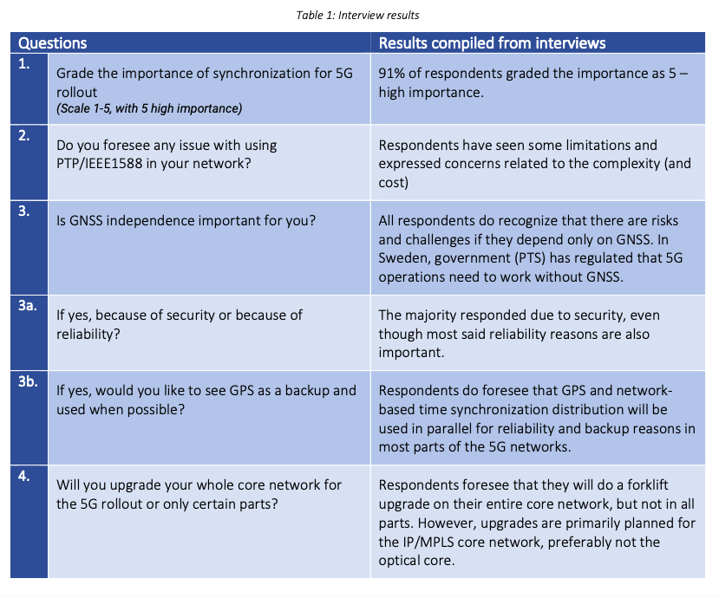
Results phase 1 and 2
State of the art conclusions
12 in depth interviews
“Solutions like Net Insight’s Time Transfer protocol that can be introduced in existing network infrastructure without major reorganization or investments in new equipment has the potential to be very attractive to the operators”

Slide 6
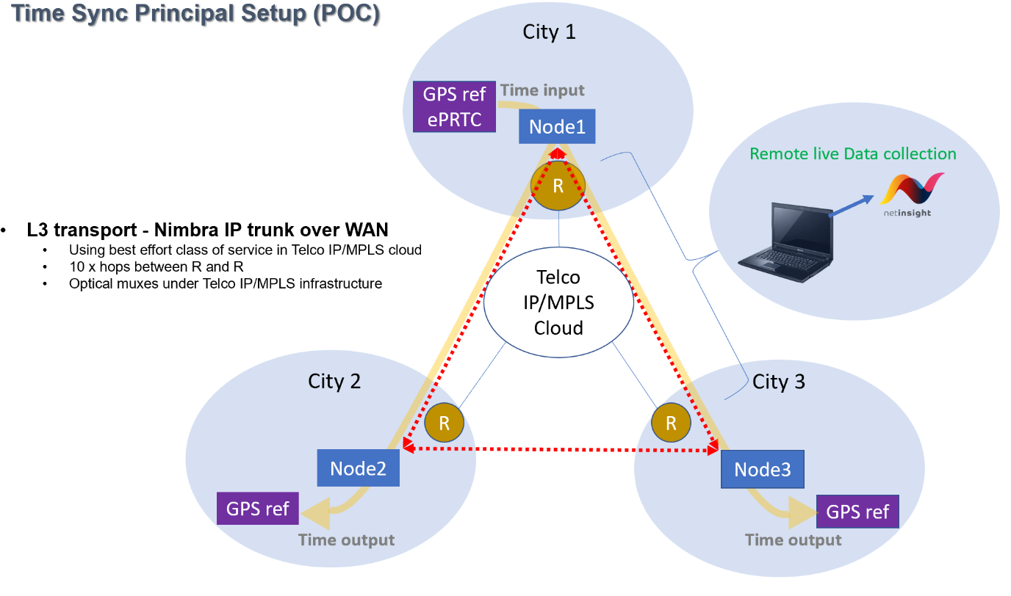
Measurements and testing
Test 1 - A long-term stability test to verify the solution can deliver the time accuracy required by 5G networks, i.e., better than ±1,5 μs absolute time across the network,
Test 2 - Showing the change in delays after a network protection switch and verifying that this will result in inaccurate time for two-way time transfer solutions, such as IEEE1588v2 and other,
Test 3 - Verifying that the Net Insight solution can detect such asymmetry shifts and continue providing an accurate clock signal.

Slide 7
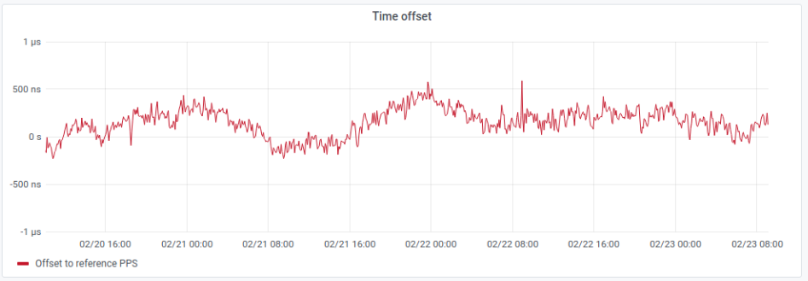
TEST 1 RESULTS
A long-time measurement was conducted over 3 days between Nimbra Node 1 and 3 to ensure the result would be within the requirements for 5G networks, i.e., within ±1,5μs.
The TE (time error) measured at node 3 is around +550 ns and -250 ns, which is well within the required ±1,5μs. However, there are optimizations to the solution and to the setup we believe can further improve the accuracy of the time sync delivery.
During the long-term test, no asymmetry changes or large time step were detected.
Figure 1: Time error measurements at node 3

Slide 8
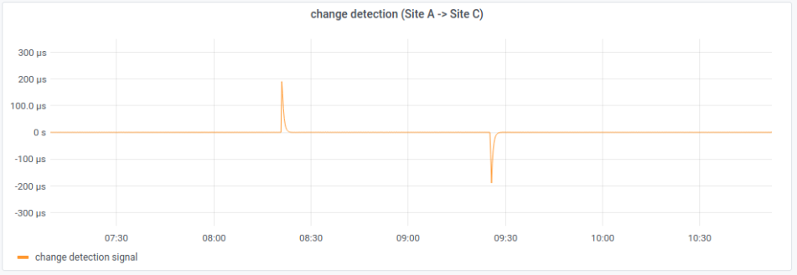
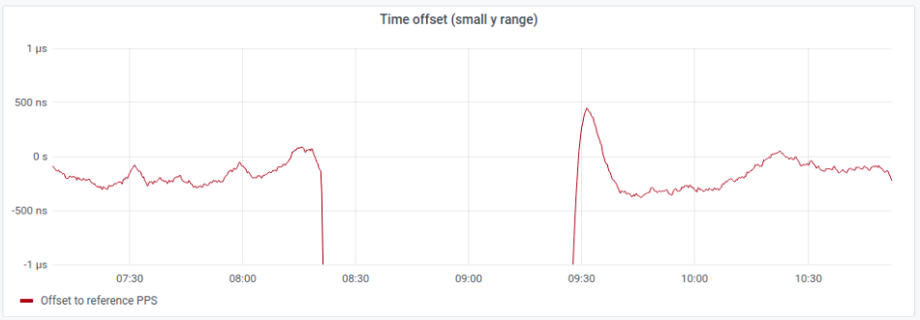
Figure 2: Delay asymmetry change detection after a switch in IP paths
TEST 2 RESULTS
Network protection switch is simulated by forcing the stream between the nodes to switch from primary to backup path provided by the telecom operator.
The switch from primary to backup path at 08:25 and back to primary path at 09:25 resulted in sudden steps which were detected by both Node1 and Node3.
Figure 3: time offset during a network protection switch – small y range(zoom)

Slide 9
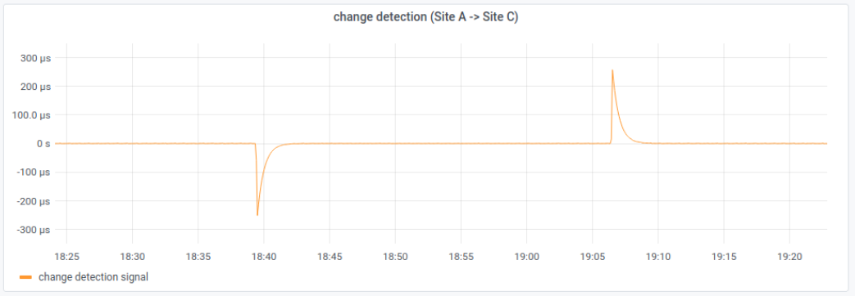
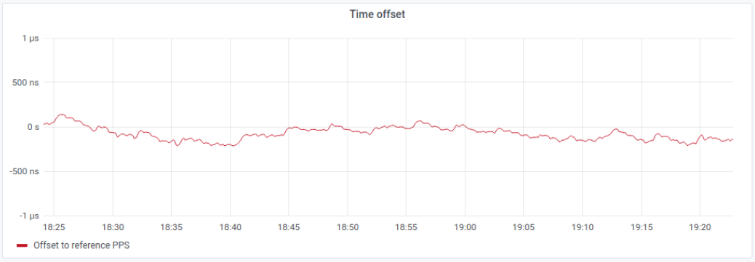
Figure 4: Delay asymmetry change detection after a switch in IP paths
TEST 3 RESULTS
Similar to test 2 but now the function to handle and compensate for the asymmetry change is included. Similarly to Test 2, the figures show that at time 18:39 and 19:07 a sudden step is detected by both Node1 and Node3.
The system is now set to detect the time shift and instead of letting the control loop act on the new asymmetrical link delays, make use of the node intelligence and automatically compensate for the asymmetries before entering the time sync control loop. In this way the large deviation of the time signal output can be avoided, and the time signal produced will see no noticeable effect from the path switches
Figure 5: Time offset results after successful delay asymmetry management

Slide 10
The end
The 5G sync Vinnova report can be found at https://netinsight.net/news/5g-sync-report-vinnova-kth/

